Slide 1
BCCA figures
March 13 2025

Slide 3
OLDER:

Slide 5
At least 5 entries – top – to get stats on % of entries or papers on these:

Slide 6
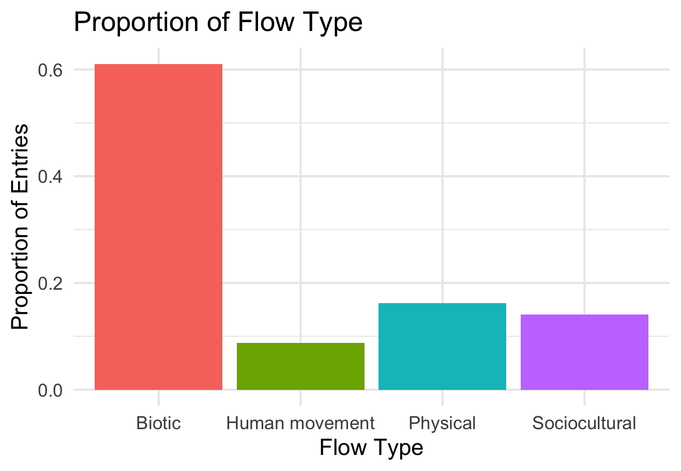

Slide 7
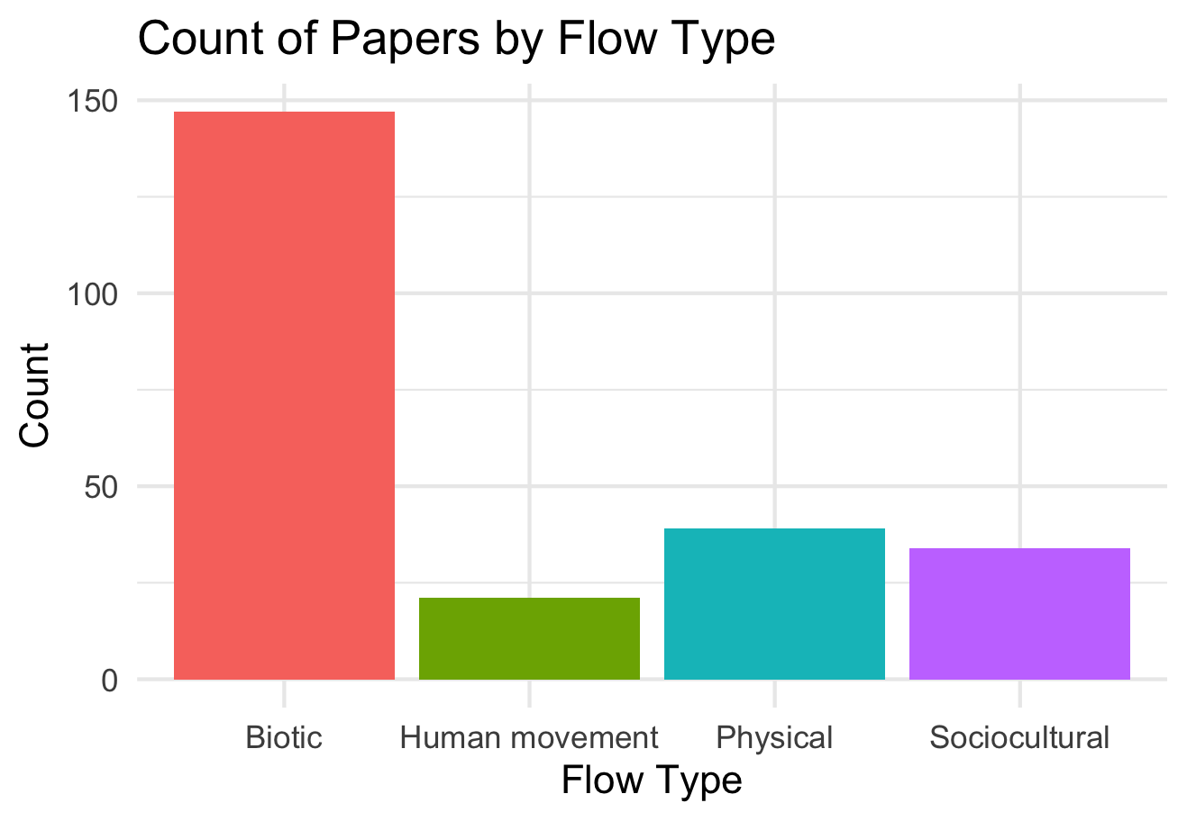

Slide 8
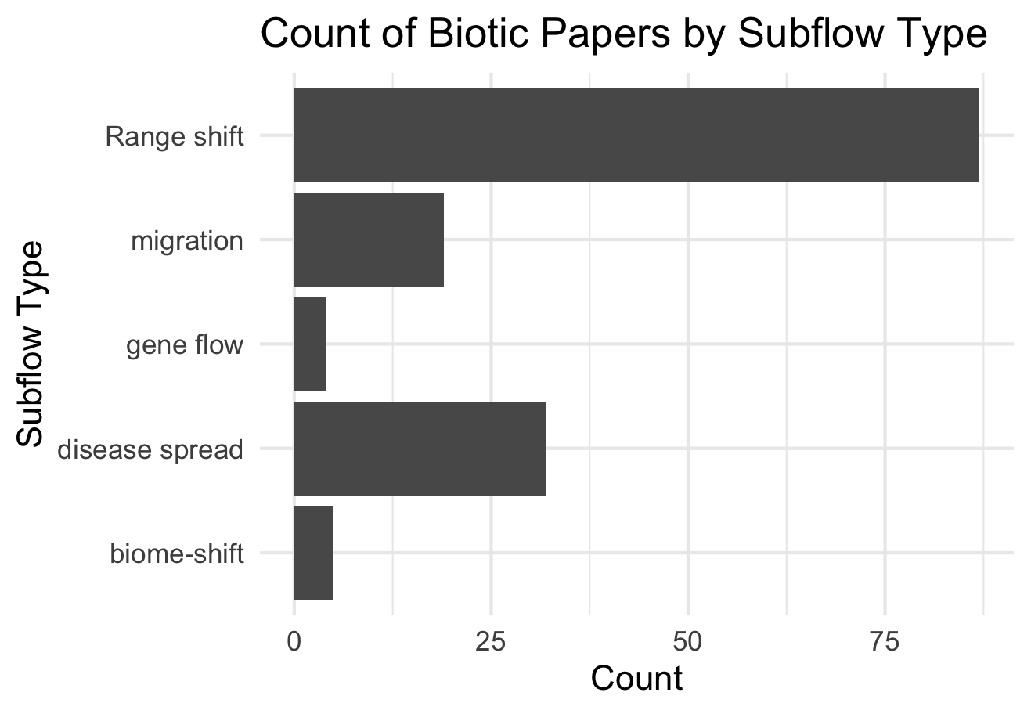

Slide 9
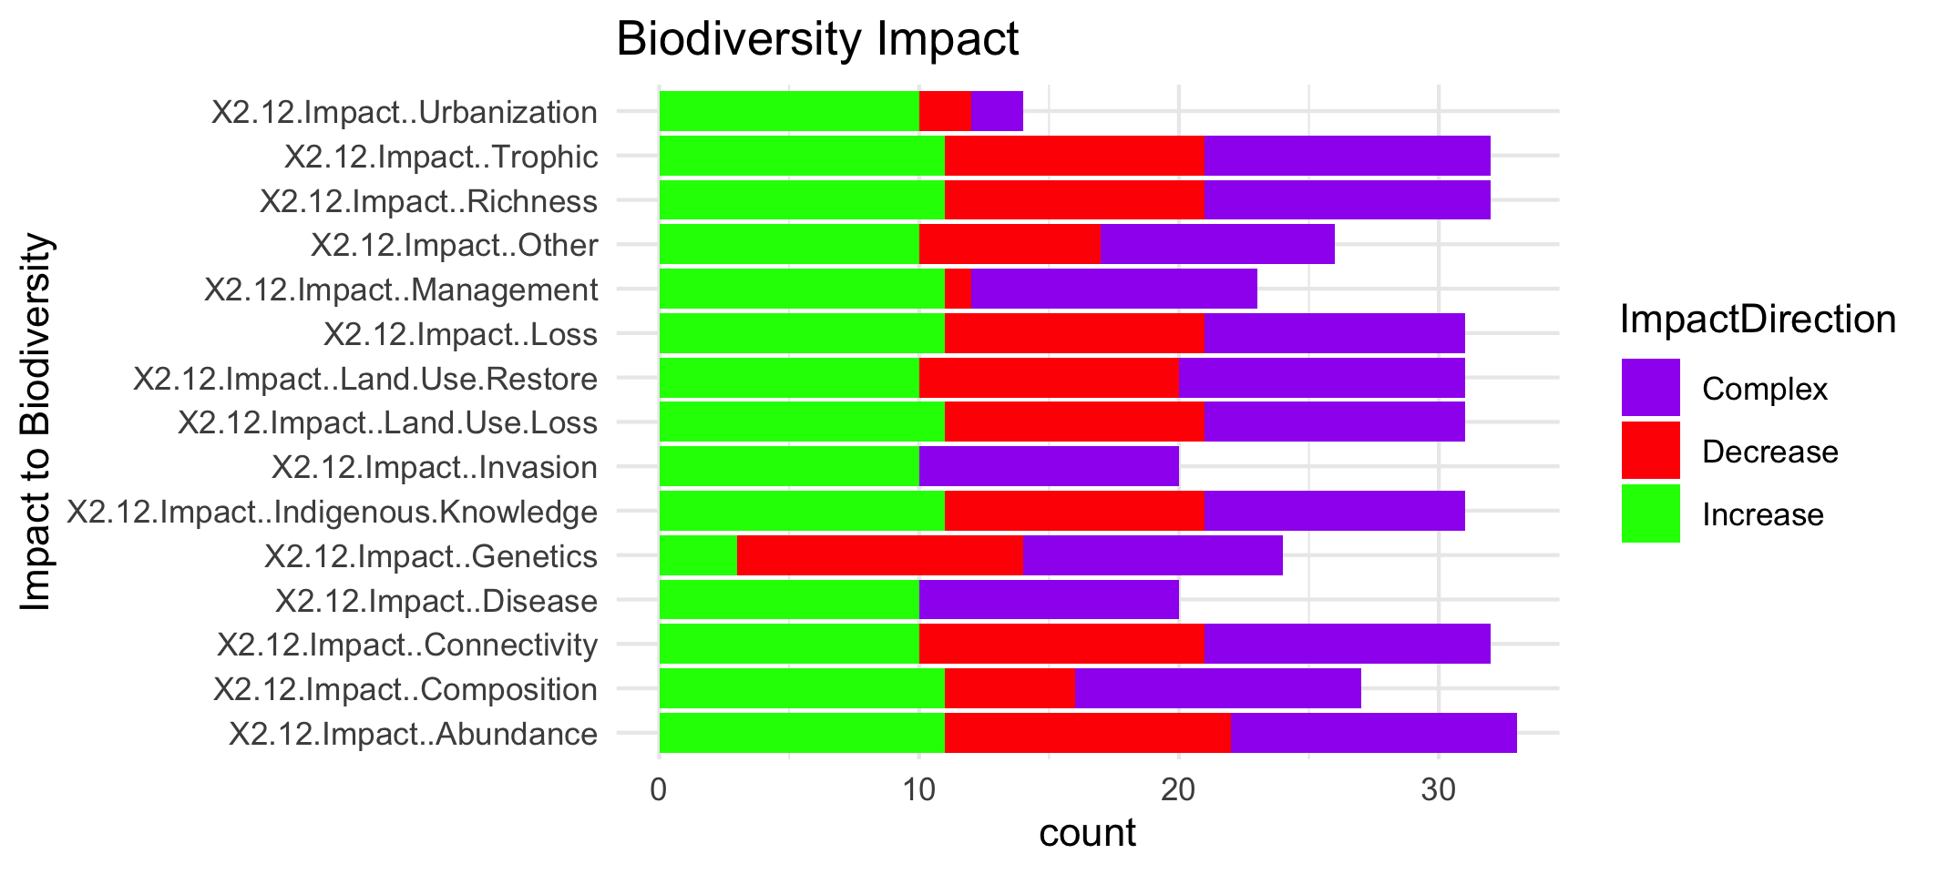

Slide 11
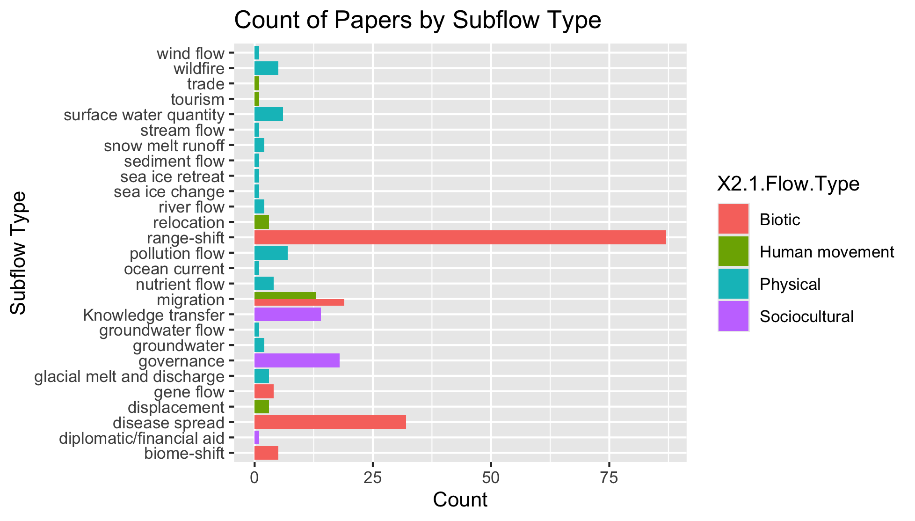
To group physical flow papers

Slide 12
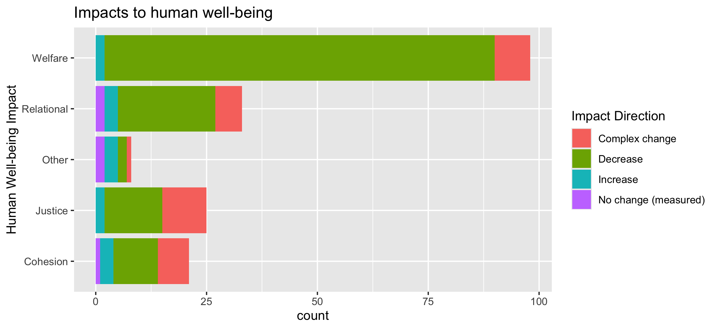
To align direction colors with final color pallet

Slide 13
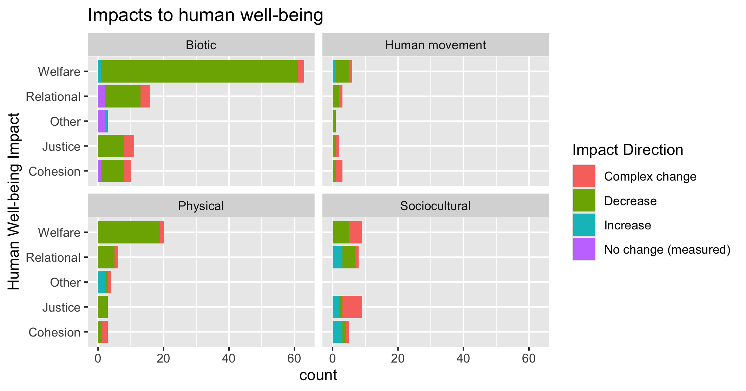
To align direction colors with final color pallet

Slide 14
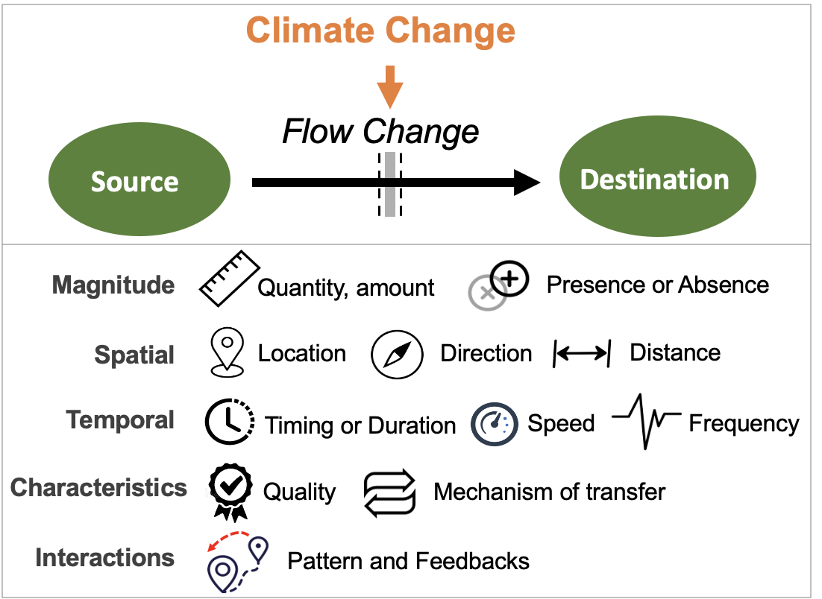
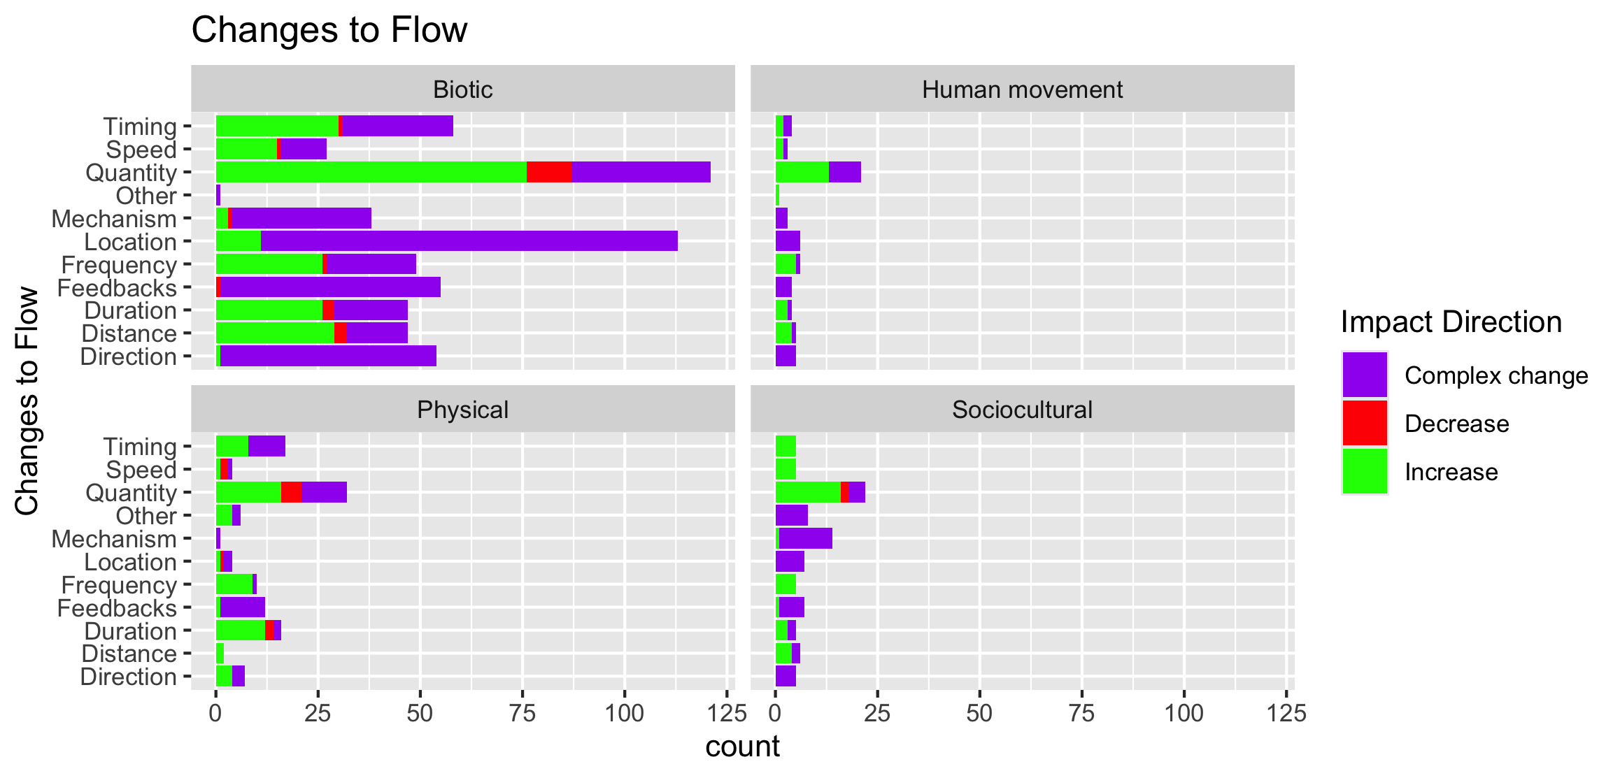

Slide 15
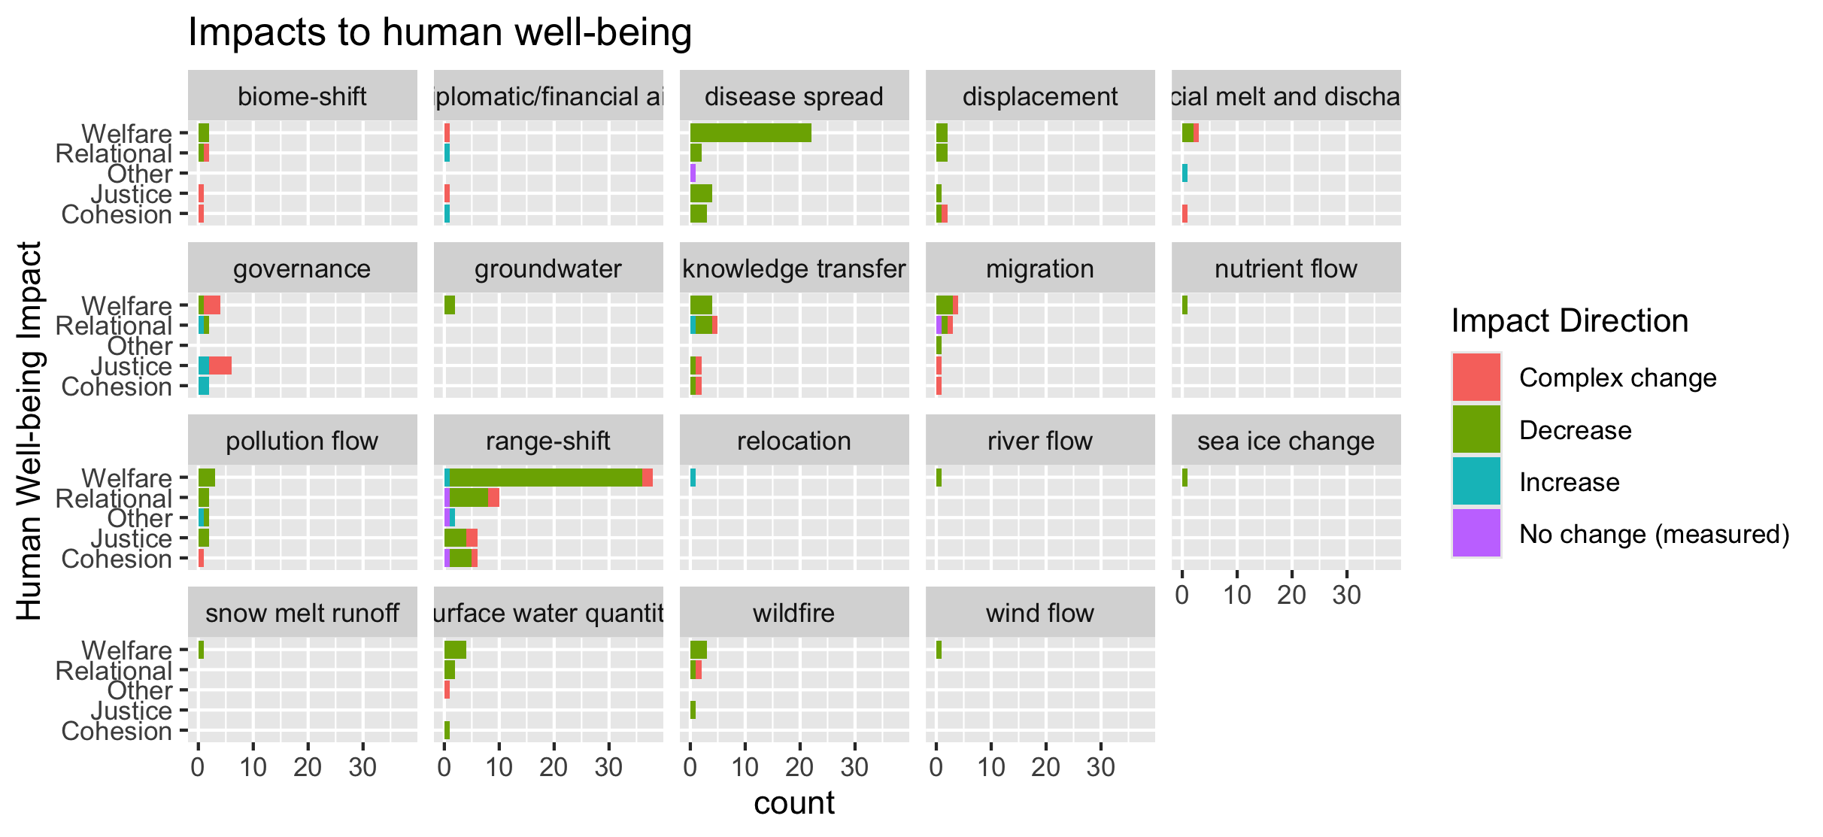
To group physical flow papers

Slide 16
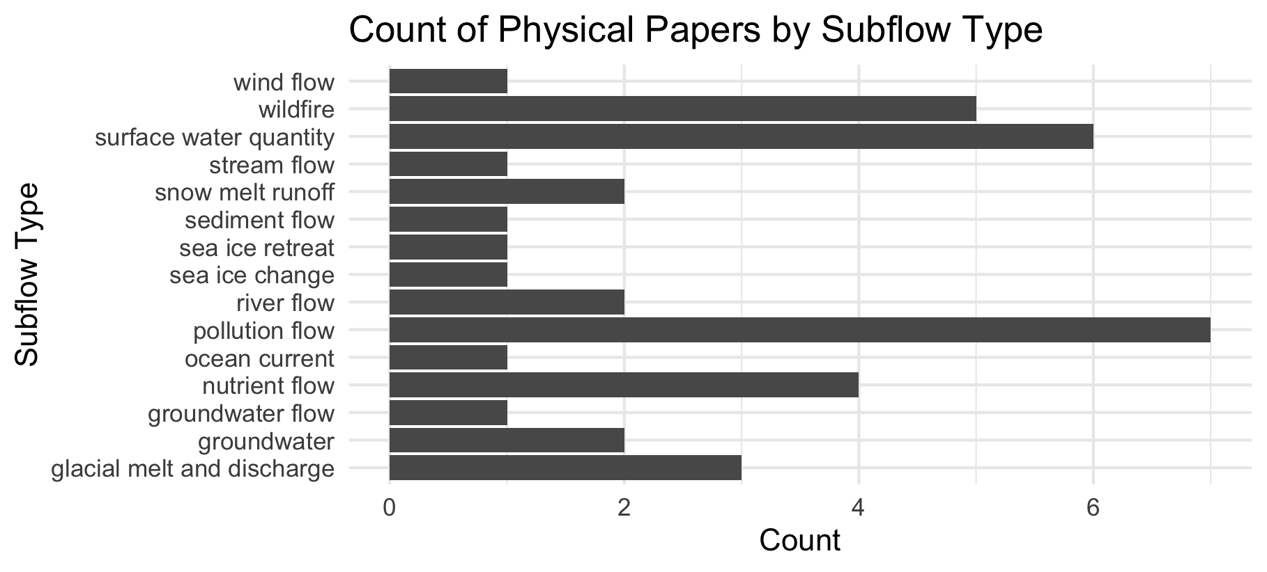

Slide 17
Feb 23 2025

Slide 18
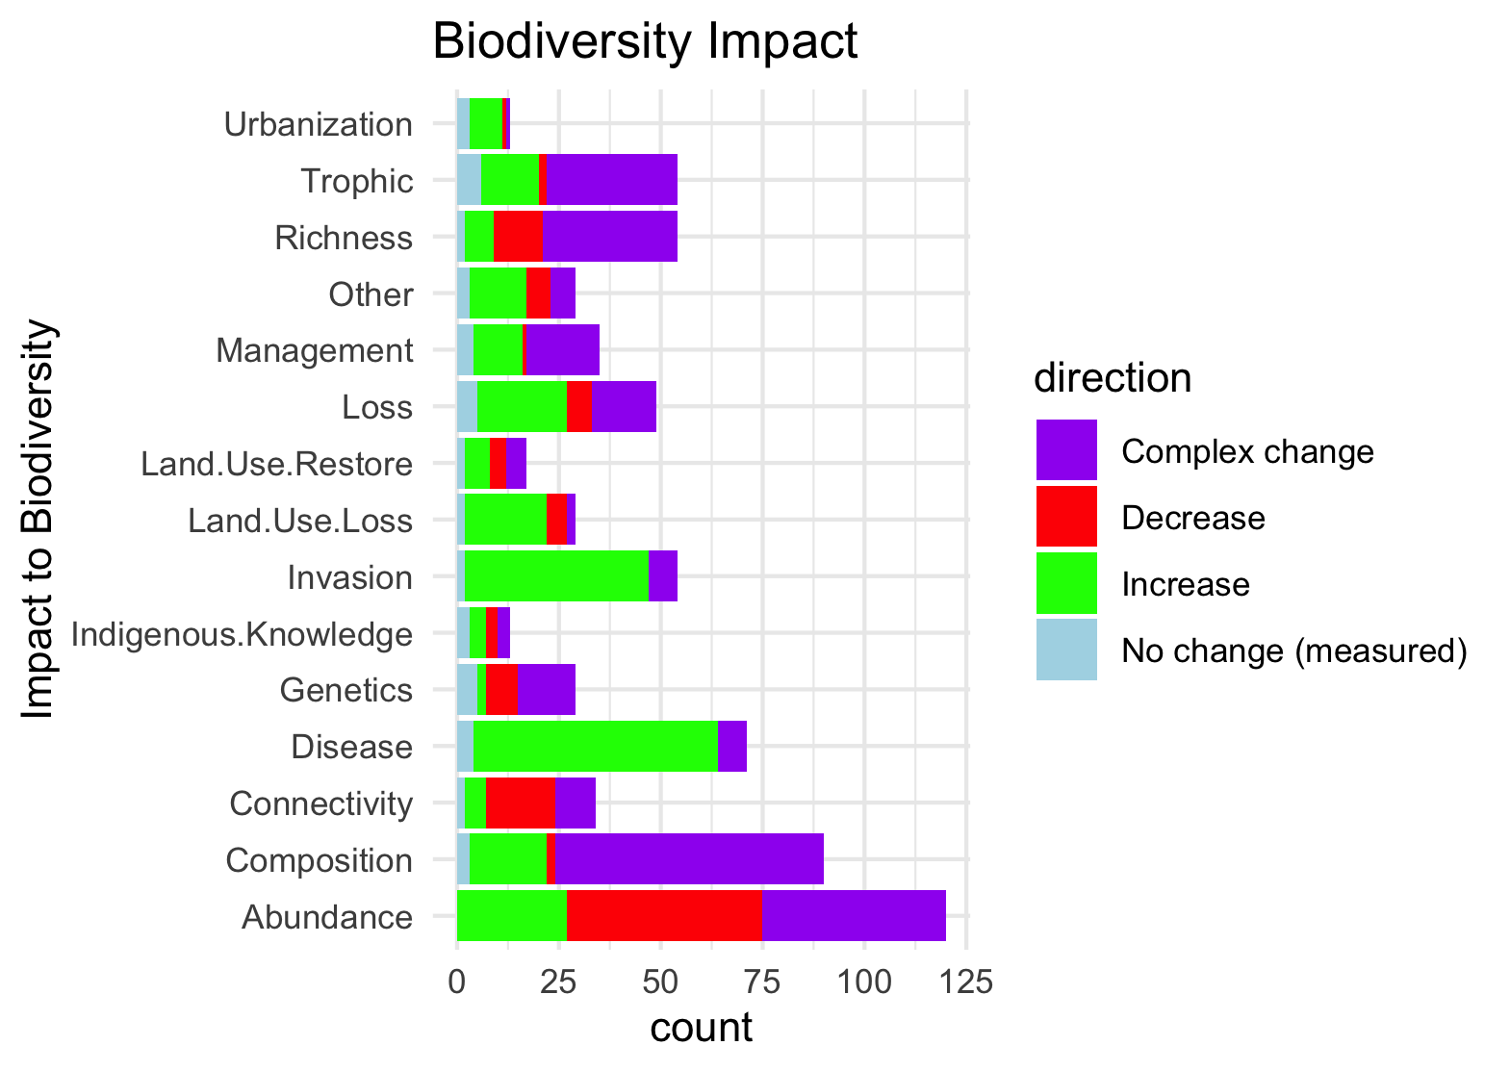
Needs to be grouped by what is good and what is bad to see increase in:

Slide 19
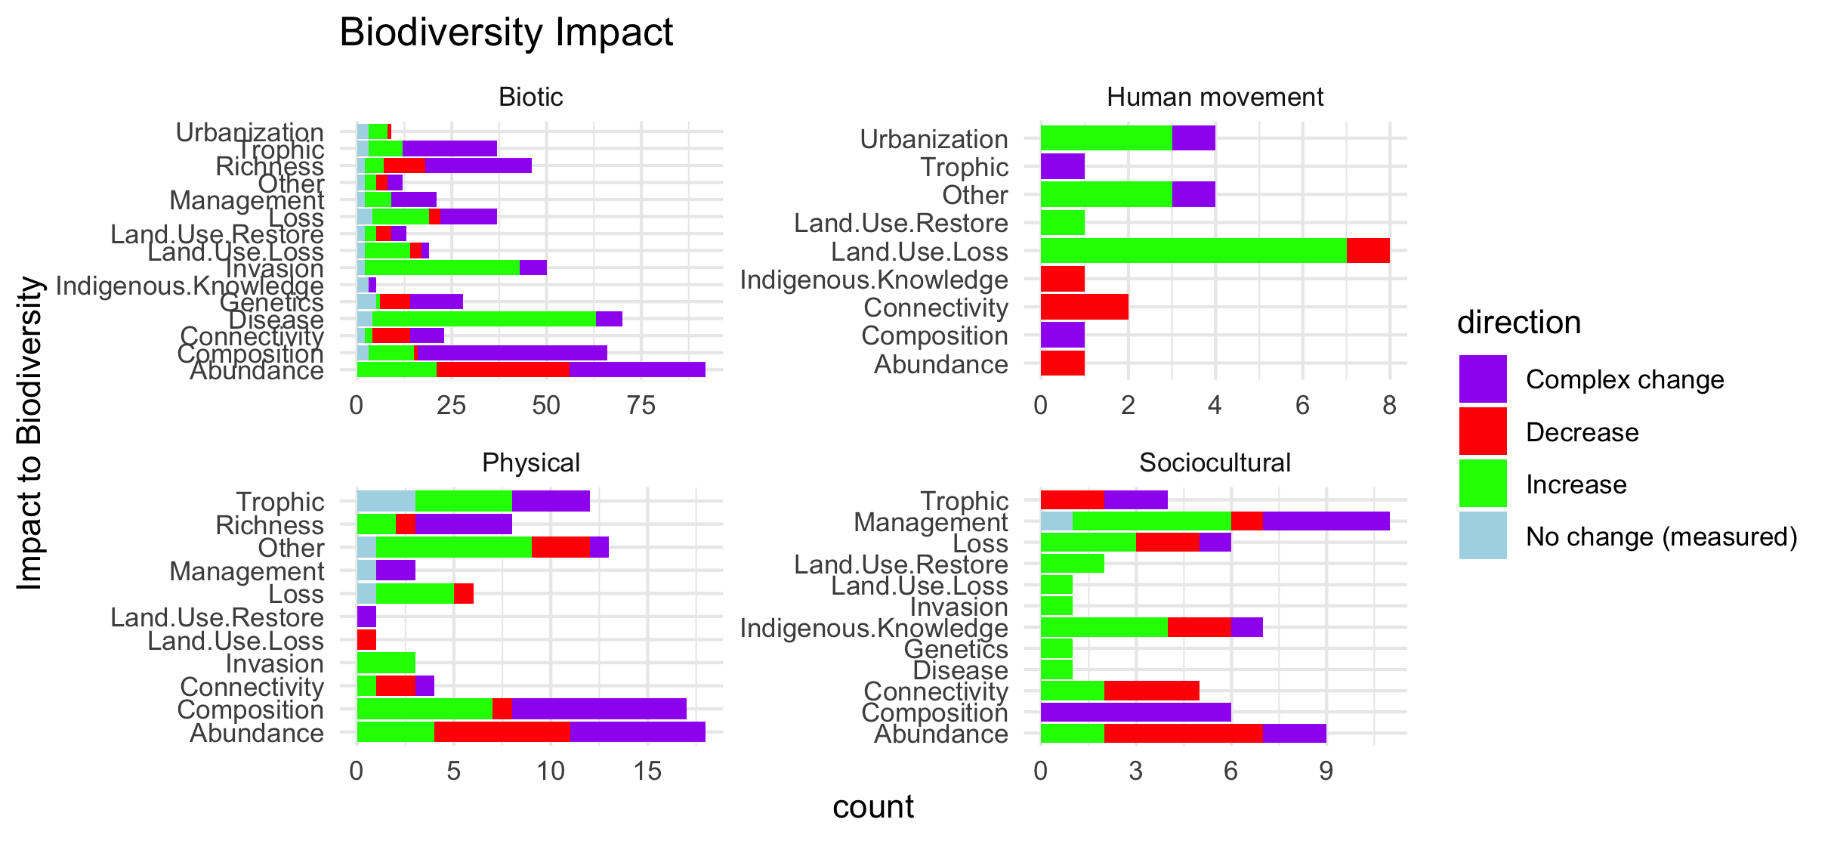
Scale free on the facet (diff x axis)

Slide 20
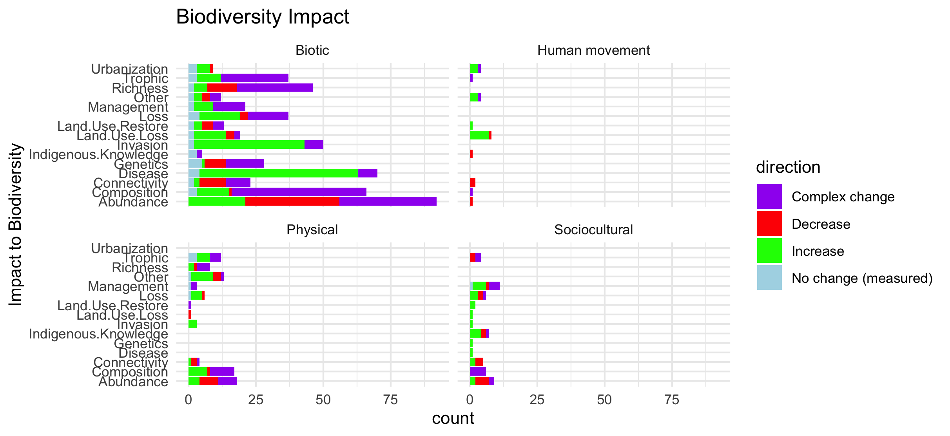
Scale fixed on the facet (same x axis)

Slide 21
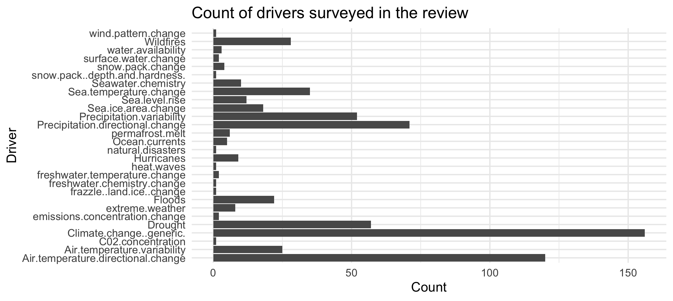

Slide 22
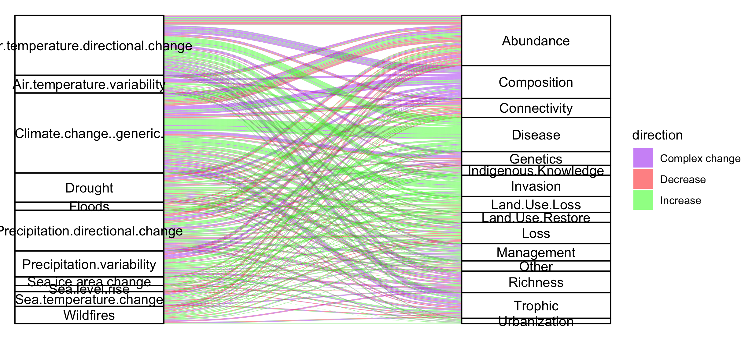
Colleen: see note isn the code – we could group spme of the drivers (hurricaines, extreme weather, ands ome of the ice ones). This still doesnt take into account if changes arw good or bad though and might just be too busy.

Slide 23
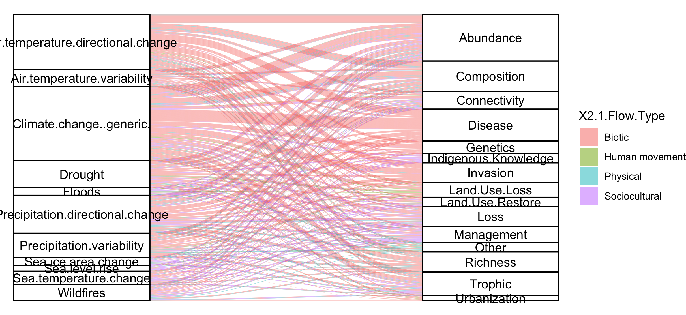
#not that informative because so many more of the papers are biotic

Slide 24
NCPs

Slide 25
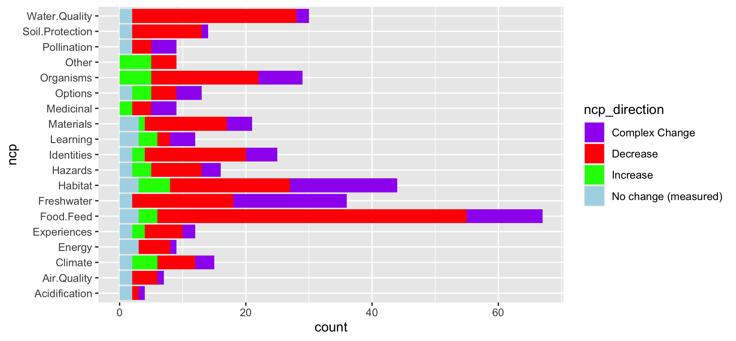
Fix labels

Slide 26
Do by flow type

Slide 27
Fix labels

Slide 28
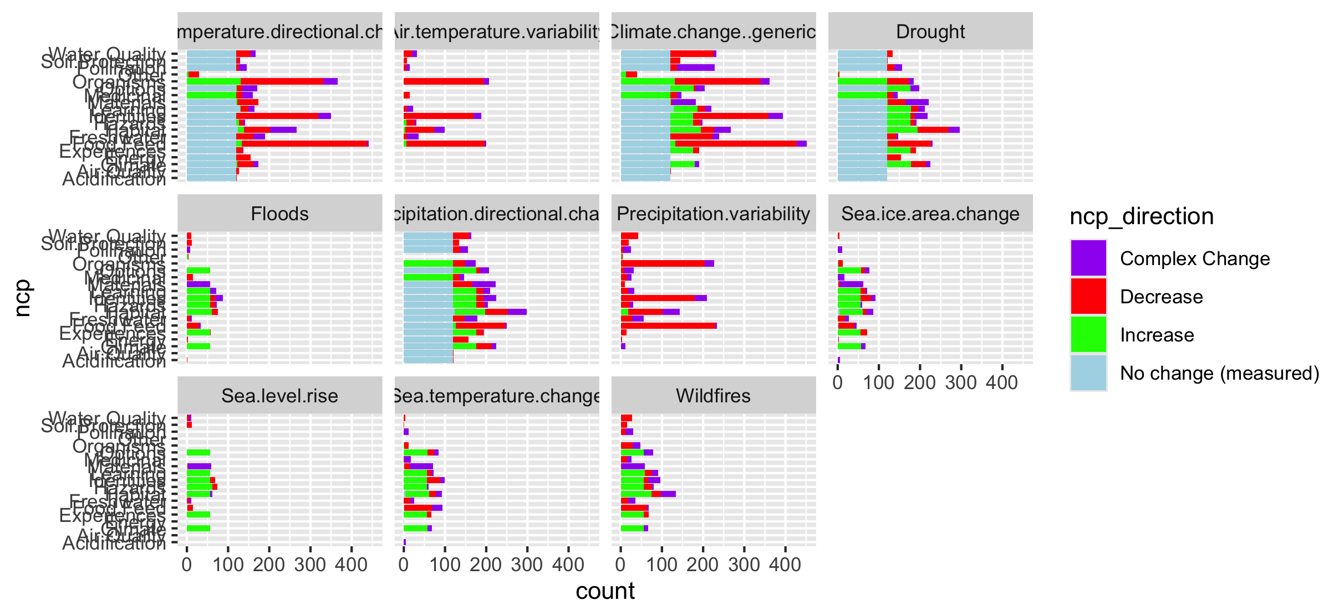

Slide 29
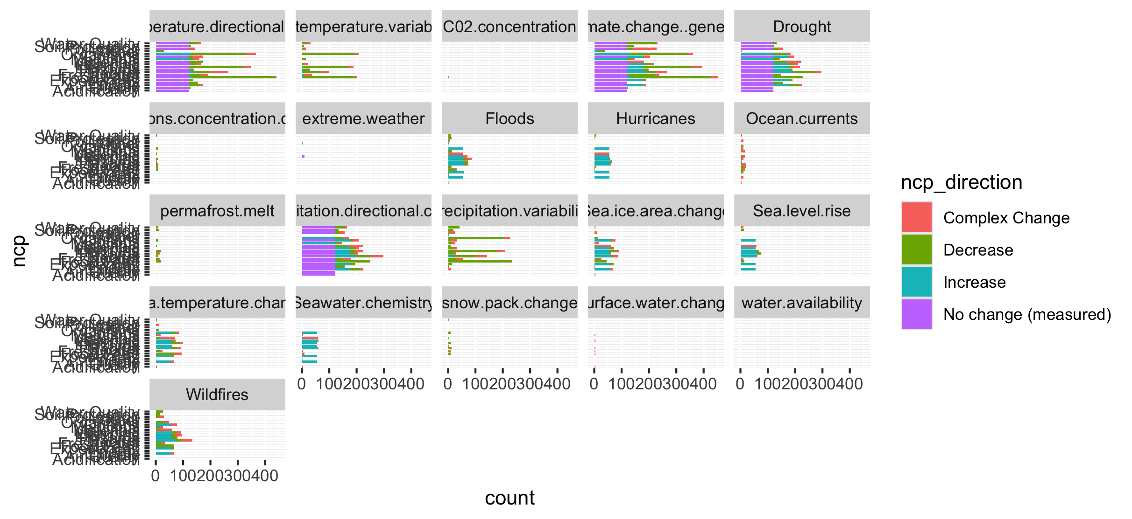
Too many drivers

Slide 30
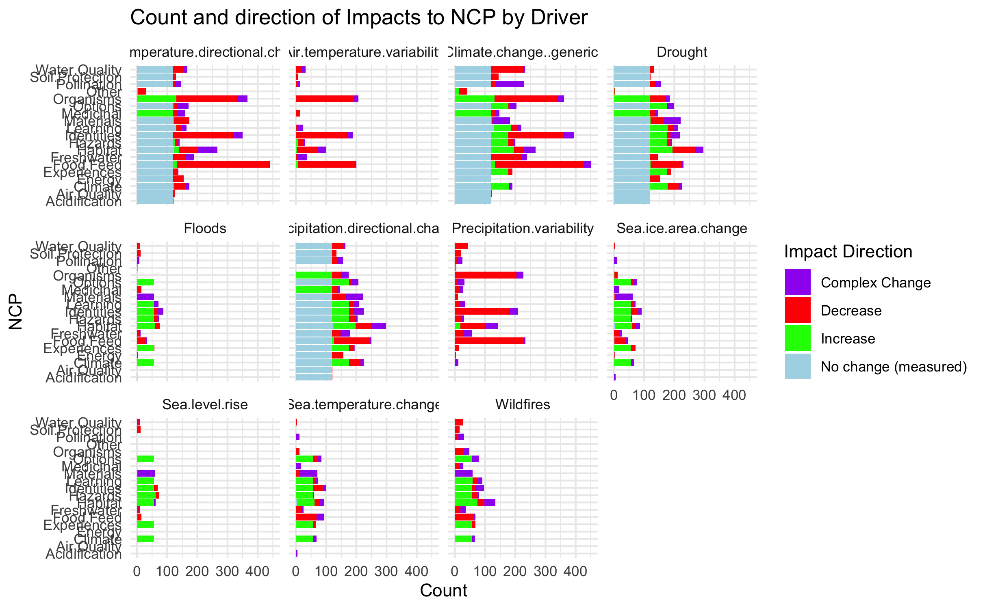

Slide 31
HWB

Slide 32
Connections – how does altered flow relate
Driver~ altered flow (by flow, and subflow – grouped out by flow
Altered flow~ impact (for each category)

